Slide 1

Programming Languages:
A Brief Overview

Slide 2

Rust
Developed by Mozilla as a systems programming language
Competes with C++
Focuses on safety, concurrency, and performance
Ownership and borrowing are unique features for memory safety

Slide 3
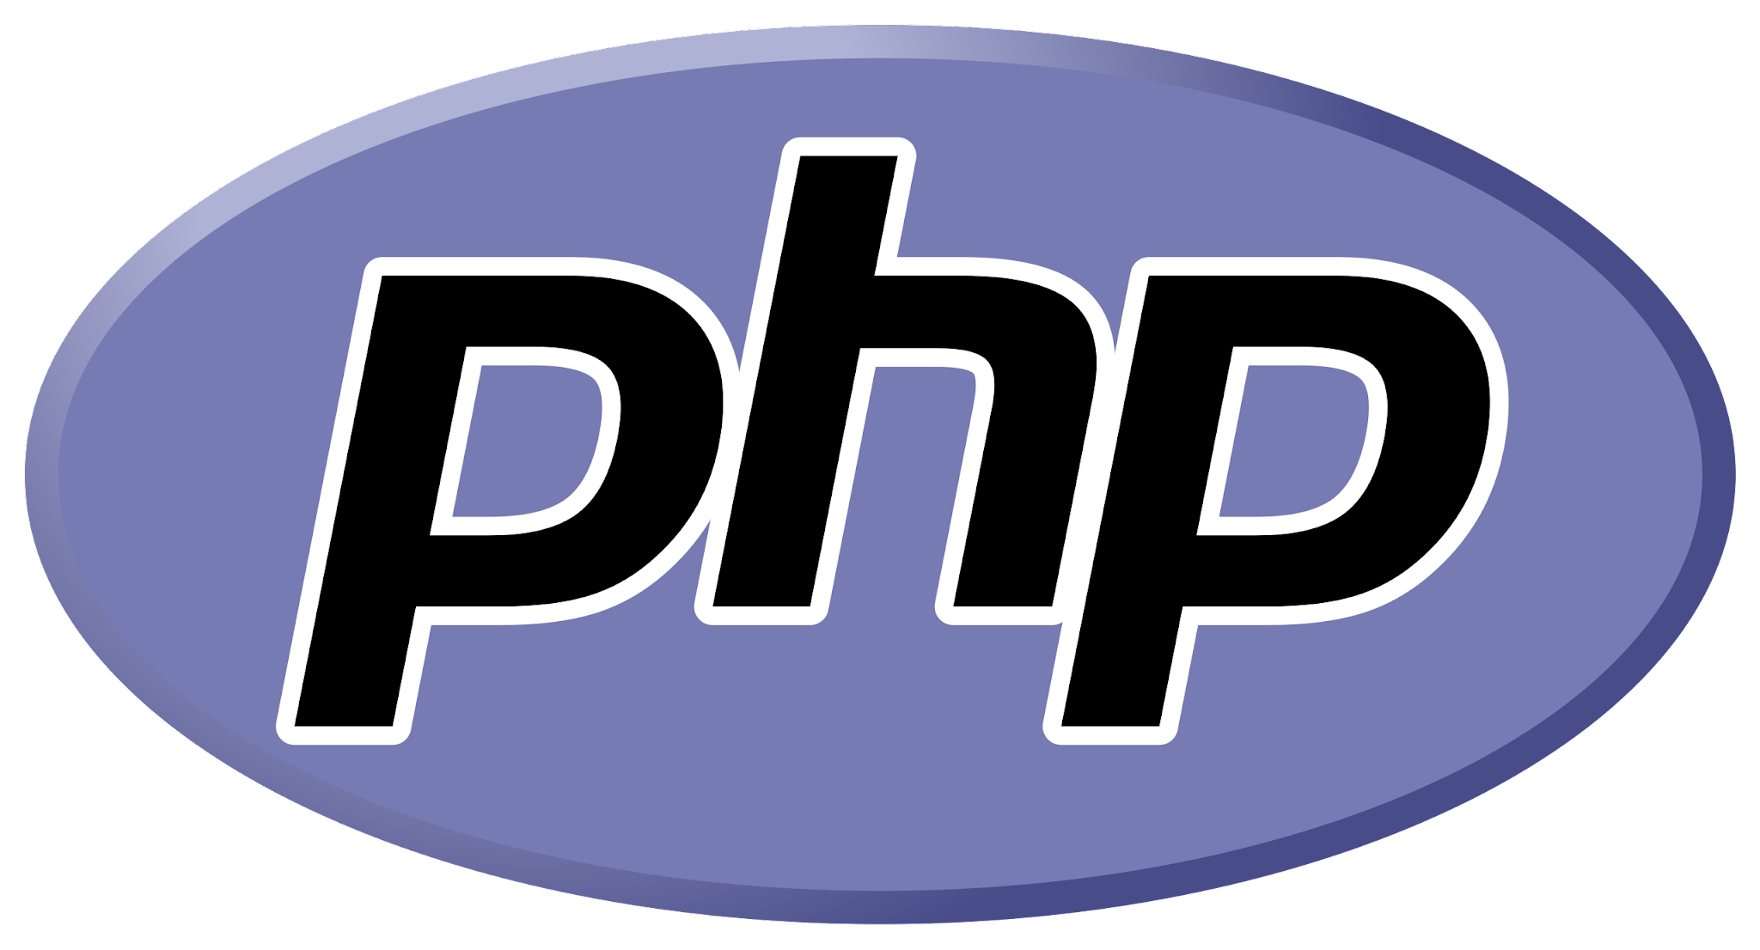
PHP
An old server-side scripting language for web development
Powers popular platforms like WordPress
Dynamic typing with a C-like syntax

Slide 4
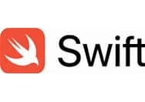
Swift
Developed by Apple for iOS, macOS, watchOS, and tvOS app development
Syntactically concise and expressive
Compatible with Objective-C libraries

Slide 5

Golang (Go)
Developed by Google
Statically typed, compiled language with garbage collection
Emphasizes simplicity and efficiency
Used in Cloud development, DevOps, Web Servers and system programming

Slide 6

Visual Basic
Developed by Microsoft, part of the .NET family
Event-driven programming paradigm
Used for both simple scripts and large applications
Visual Basic for Applications (VBA): MS Office automation

Slide 7
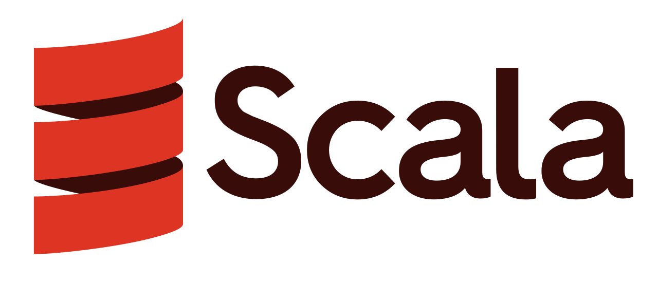

Functional Languages
Haskell: purely functional, lazy evaluation, strong static typing
Scala: blends object-oriented and functional programming, runs on the JVM.

Slide 8
Oddities: Brainfuck
Created in 1993 as mostly an academic exercise in minimalism
Minimalistic language with only eight commands
Despite it being a half-joke, it's fully Turing complete
Even a Hello World program is several pages long

Slide 9
Thank you!
Q & A

